Slide 1


Object Oriented Programming and Design WEEK 4 – Class and Objects in Java

Slide 2
Revision Topic
Loop
for loop
while loop
do while loop
for each loop
Array
1D Array
Multi-Dimensional Array

Slide 3
LET’S GET STARTED WITH LECTURE 4

Slide 4
Class and objects in Java

Slide 5
1. Class/ Object
1.1. Java Classes
1.2. Components in Java Class
1.3. Class Declaration in java
1.4. Java Object
1.5. Declaring Java Object
1.6. Class Vs Object
2 Java Methods
2.1. Declaration of methods
2.2. Types of methods
2.2.1 Predefined methods
2.2.2 User-defined methods
2.3. Ways to create methods
2.3.1 Instance Methods
2.3.2 Static Methods
2.3.3 Static vs instance
2.4. Rule to name methods
2.5. Methods Calling
3. Variables in Java
4. Java Class Constructor
4.1. Rules to create Constructor
4.2. Java Methods vs Constructor
4.3. Types of Constructor
4.4. Constructor Overloading
5. Java Access Modifier
6. Four Pillar of OOP
7. Encapsulation in Java
7.1. Getters and Setters
7.2. Implementation of Encapsulation
Java classes
“Class is the basis of all Computation in Java”
A class is a collection of objects that have similar characteristics, behaviours, and attributes.
Class is not a real world entity. It is just a template or blueprint or prototype from which objects are created.
Class does not occupy memory.
Class is a group of variables of different data types and group of methods.
Modifiers(public)
Class Keyword (class)
Class Name(Student)

Slide 6
1. Class/ Object
1.1. Java Classes
1.2. Components in Java Class
1.3. Class Declaration in java
1.4. Java Object
1.5. Declaring Java Object
1.6. Class Vs Object
2 Java Methods
2.1. Declaration of methods
2.2. Types of methods
2.2.1 Predefined methods
2.2.2 User-defined methods
2.3. Ways to create methods
2.3.1 Instance Methods
2.3.2 Static Methods
2.3.3 Static vs instance
2.4. Rule to name methods
2.5. Methods Calling
3. Variables in Java
4. Java Class Constructor
4.1. Rules to create Constructor
4.2. Java Methods vs Constructor
4.3. Types of Constructor
4.4. Constructor Overloading
5. Java Access Modifier
6. Four Pillar of OOP
7. Encapsulation in Java
7.1. Getters and Setters
7.2. Implementation of Encapsulation
Components of Java Class
Modifiers: A class can be public or has default access.
Class keyword: class keyword is used to create a class.
Class name: The name should begin with an initial letter (capitalized by convention).
Superclass(if any): The name of the class’s parent (superclass), if any, preceded by the keyword extends. A class can only extend (subclass) one parent.
Interfaces(if any): A class can implement more than one interface.
Body: The class body is surrounded by braces, { }.

Slide 7
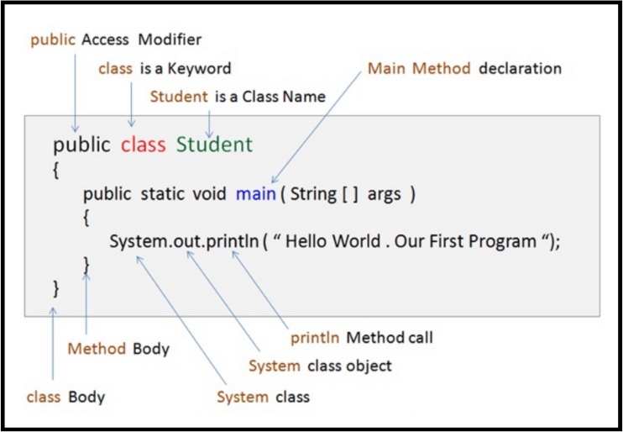
1. Class/ Object
1.1. Java Classes
1.2. Components in Java Class
1.3. Class Declaration in java
1.4. Java Object
1.5. Declaring Java Object
1.6. Class Vs Object
2 Java Methods
2.1. Declaration of methods
2.2. Types of methods
2.2.1 Predefined methods
2.2.2 User-defined methods
2.3. Ways to create methods
2.3.1 Instance Methods
2.3.2 Static Methods
2.3.3 Static vs instance
2.4. Rule to name methods
2.5. Methods Calling
3. Variables in Java
4. Java Class Constructor
4.1. Rules to create Constructor
4.2. Java Methods vs Constructor
4.3. Types of Constructor
4.4. Constructor Overloading
5. Java Access Modifier
6. Four Pillar of OOP
7. Encapsulation in Java
7.1. Getters and Setters
7.2. Implementation of Encapsulation
Class declaration in Java

Slide 8
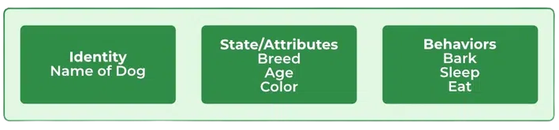
1. Class/ Object
1.1. Java Classes
1.2. Components in Java Class
1.3. Class Declaration in java
1.4. Java Object
1.5. Declaring Java Object
1.6. Class Vs Object
2 Java Methods
2.1. Declaration of methods
2.2. Types of methods
2.2.1 Predefined methods
2.2.2 User-defined methods
2.3. Ways to create methods
2.3.1 Instance Methods
2.3.2 Static Methods
2.3.3 Static vs instance
2.4. Rule to name methods
2.5. Methods Calling
3. Variables in Java
4. Java Class Constructor
4.1. Rules to create Constructor
4.2. Java Methods vs Constructor
4.3. Types of Constructor
4.4. Constructor Overloading
5. Java Access Modifier
6. Four Pillar of OOP
7. Encapsulation in Java
7.1. Getters and Setters
7.2. Implementation of Encapsulation
Java objects
An object in Java is a basic unit of Object-Oriented
Programming and represents real-life entities.
An object consists of :
State: It is represented by attributes of an object. It also reflects the properties of an object.
Behavior: It is represented by the methods of an object. It also reflects the response of an object with other objects.
Identity: It gives a unique name to an object and enables one object to interact with other objects.

Slide 9
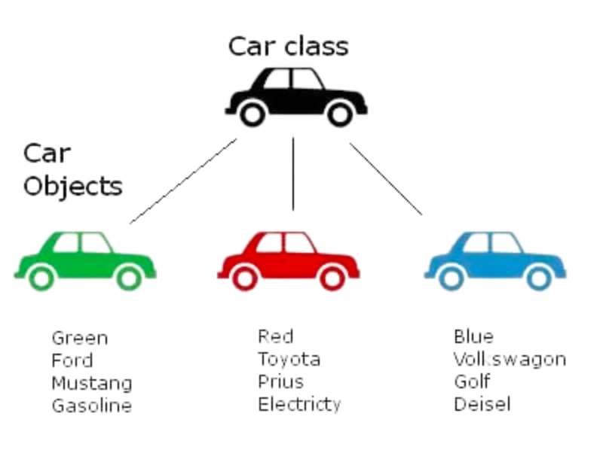
1. Class/ Object
1.1. Java Classes
1.2. Components in Java Class
1.3. Class Declaration in java
1.4. Java Object
1.5. Declaring Java Object
1.6. Class Vs Object
2 Java Methods
2.1. Declaration of methods
2.2. Types of methods
2.2.1 Predefined methods
2.2.2 User-defined methods
2.3. Ways to create methods
2.3.1 Instance Methods
2.3.2 Static Methods
2.3.3 Static vs instance
2.4. Rule to name methods
2.5. Methods Calling
3. Variables in Java
4. Java Class Constructor
4.1. Rules to create Constructor
4.2. Java Methods vs Constructor
4.3. Types of Constructor
4.4. Constructor Overloading
5. Java Access Modifier
6. Four Pillar of OOP
7. Encapsulation in Java
7.1. Getters and Setters
7.2. Implementation of Encapsulation
Java objects
For example: Let us suppose there is a class name as planet than Earth and Venus can be its object.
Use the new operator to construct objects.
Give each object a unique name (like variables).
Scanner in = new Scanner(System.in);
Object

Slide 10
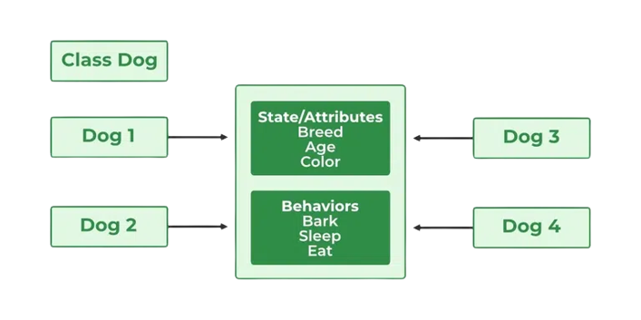
1. Class/ Object
1.1. Java Classes
1.2. Components in Java Class
1.3. Class Declaration in java
1.4. Java Object
1.5. Declaring Java Object
1.6. Class Vs Object
2 Java Methods
2.1. Declaration of methods
2.2. Types of methods
2.2.1 Predefined methods
2.2.2 User-defined methods
2.3. Ways to create methods
2.3.1 Instance Methods
2.3.2 Static Methods
2.3.3 Static vs instance
2.4. Rule to name methods
2.5. Methods Calling
3. Variables in Java
4. Java Class Constructor
4.1. Rules to create Constructor
4.2. Java Methods vs Constructor
4.3. Types of Constructor
4.4. Constructor Overloading
5. Java Access Modifier
6. Four Pillar of OOP
7. Encapsulation in Java
7.1. Getters and Setters
7.2. Implementation of Encapsulation
Declaring Objects
(Instantiating a class)
When an object of a class is created, the class is said to be instantiated. All the instances share the attributes and the behavior of the class. A single class may have any number of instances.

Slide 11
1. Class/ Object
1.1. Java Classes
1.2. Components in Java Class
1.3. Class Declaration in java
1.4. Java Object
1.5. Declaring Java Object
1.6. Class Vs Object
2 Java Methods
2.1. Declaration of methods
2.2. Types of methods
2.2.1 Predefined methods
2.2.2 User-defined methods
2.3. Ways to create methods
2.3.1 Instance Methods
2.3.2 Static Methods
2.3.3 Static vs instance
2.4. Rule to name methods
2.5. Methods Calling
3. Variables in Java
4. Java Class Constructor
4.1. Rules to create Constructor
4.2. Java Methods vs Constructor
4.3. Types of Constructor
4.4. Constructor Overloading
5. Java Access Modifier
6. Four Pillar of OOP
7. Encapsulation in Java
7.1. Getters and Setters
7.2. Implementation of Encapsulation
Instantiating a class
public class MotorBike {
int speed; //(data/state/fields)
void speed(){ //(behaviour/method)
System.out.print(“Bike Running at 100km/s”);
} public static void main(String[] args) { MotorBike ducati= new MotorBike(); //Object of MotorBike Class MotorBike honda = new MotorBike(); //Object of MotorBike Class } }

Slide 12
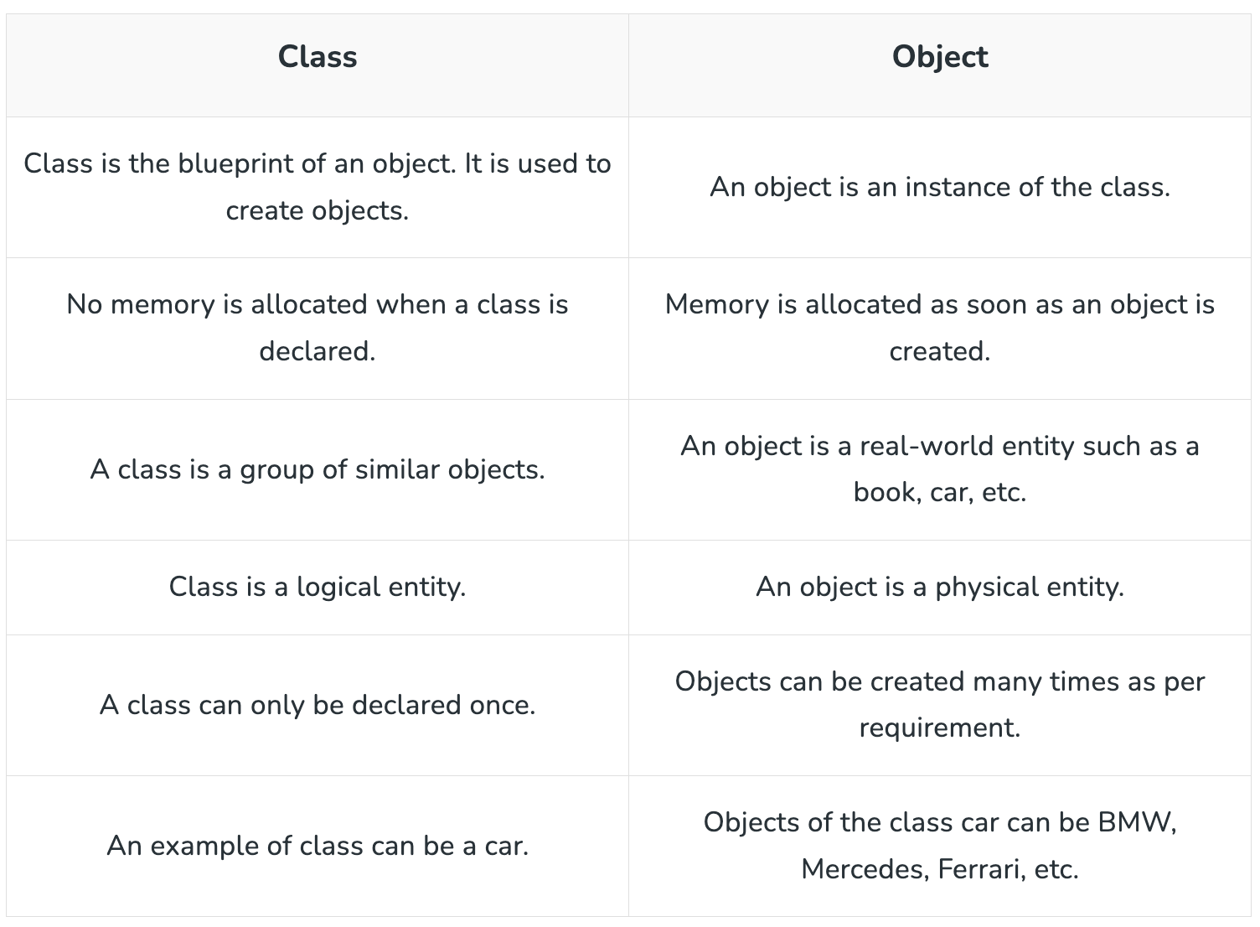
1. Class/ Object
1.1. Java Classes
1.2. Components in Java Class
1.3. Class Declaration in java
1.4. Java Object
1.5. Declaring Java Object
1.6. Class Vs Object
2 Java Methods
2.1. Declaration of methods
2.2. Types of methods
2.2.1 Predefined methods
2.2.2 User-defined methods
2.3. Ways to create methods
2.3.1 Instance Methods
2.3.2 Static Methods
2.3.3 Static vs instance
2.4. Rule to name methods
2.5. Methods Calling
3. Variables in Java
4. Java Class Constructor
4.1. Rules to create Constructor
4.2. Java Methods vs Constructor
4.3. Types of Constructor
4.4. Constructor Overloading
5. Java Access Modifier
6. Four Pillar of OOP
7. Encapsulation in Java
7.1. Getters and Setters
7.2. Implementation of Encapsulation
Differences between class and object

Slide 13
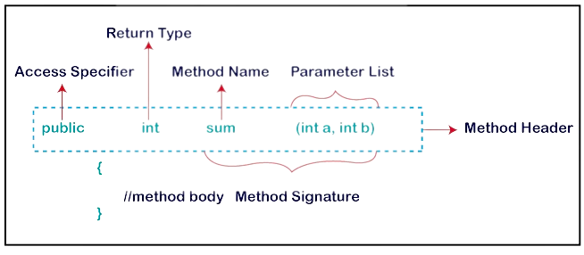
1. Class/ Object
1.1. Java Classes
1.2. Components in Java Class
1.3. Class Declaration in java
1.4. Java Object
1.5. Declaring Java Object
1.6. Class Vs Object
2 Java Methods
2.1. Declaration of methods
2.2. Types of methods
2.2.1 Predefined methods
2.2.2 User-defined methods
2.3. Ways to create methods
2.3.1 Instance Methods
2.3.2 Static Methods
2.3.3 Static vs instance
2.4. Rule to name methods
2.5. Methods Calling
3. Variables in Java
4. Java Class Constructor
4.1. Rules to create Constructor
4.2. Java Methods vs Constructor
4.3. Types of Constructor
4.4. Constructor Overloading
5. Java Access Modifier
6. Four Pillar of OOP
7. Encapsulation in Java
7.1. Getters and Setters
7.2. Implementation of Encapsulation
Java Methods
A method is a block of code or collection of statements
or a set of code grouped together to perform a certain task or operation.
It is used to achieve the reusability of code.
Method Declaration
The method declaration provides information about method attributes, such as visibility, return-type, name, and arguments. It has six components that are known as method header, as we have shown in the following figure.

Slide 14
1. Class/ Object
1.1. Java Classes
1.2. Components in Java Class
1.3. Class Declaration in java
1.4. Java Object
1.5. Declaring Java Object
1.6. Class Vs Object
2 Java Methods
2.1. Declaration of methods
2.2. Types of methods
2.2.1 Predefined methods
2.2.2 User-defined methods
2.3. Ways to create methods
2.3.1 Instance Methods
2.3.2 Static Methods
2.3.3 Static vs instance
2.4. Rule to name methods
2.5. Methods Calling
3. Variables in Java
4. Java Class Constructor
4.1. Rules to create Constructor
4.2. Java Methods vs Constructor
4.3. Types of Constructor
4.4. Constructor Overloading
5. Java Access Modifier
6. Four Pillar of OOP
7. Encapsulation in Java
7.1. Getters and Setters
7.2. Implementation of Encapsulation
Method Declaration
Method Signature: Every method has a method
signature. It is a part of the method declaration. It includes the method name and parameter list.
Access Specifier: Access specifier or modifier is the access type of the method. It specifies the visibility of the method.
Return Type: Return type is a data type that the method returns. It may have a primitive data type, object, collection, void, etc. If the method does not return anything, we use void keyword.

Slide 15
1. Class/ Object
1.1. Java Classes
1.2. Components in Java Class
1.3. Class Declaration in java
1.4. Java Object
1.5. Declaring Java Object
1.6. Class Vs Object
2 Java Methods
2.1. Declaration of methods
2.2. Types of methods
2.2.1 Predefined methods
2.2.2 User-defined methods
2.3. Ways to create methods
2.3.1 Instance Methods
2.3.2 Static Methods
2.3.3 Static vs instance
2.4. Rule to name methods
2.5. Methods Calling
3. Variables in Java
4. Java Class Constructor
4.1. Rules to create Constructor
4.2. Java Methods vs Constructor
4.3. Types of Constructor
4.4. Constructor Overloading
5. Java Access Modifier
6. Four Pillar of OOP
7. Encapsulation in Java
7.1. Getters and Setters
7.2. Implementation of Encapsulation
Method Declaration
Method Name: It is a unique name that is used to define the name of a method. It must be corresponding to the functionality of the method.
Parameter List: It is the list of parameters separated by a comma and enclosed in the pair of parentheses. It contains the data type and variable name.
Method Body: It is a part of the method declaration. It contains all the actions to be performed. It is enclosed within the pair of curly braces.

Slide 16
1. Class/ Object
1.1. Java Classes
1.2. Components in Java Class
1.3. Class Declaration in java
1.4. Java Object
1.5. Declaring Java Object
1.6. Class Vs Object
2 Java Methods
2.1. Declaration of methods
2.2. Types of methods
2.2.1 Predefined methods
2.2.2 User-defined methods
2.3. Ways to create methods
2.3.1 Instance Methods
2.3.2 Static Methods
2.3.3 Static vs instance
2.4. Rule to name methods
2.5. Methods Calling
3. Variables in Java
4. Java Class Constructor
4.1. Rules to create Constructor
4.2. Java Methods vs Constructor
4.3. Types of Constructor
4.4. Constructor Overloading
5. Java Access Modifier
6. Four Pillar of OOP
7. Encapsulation in Java
7.1. Getters and Setters
7.2. Implementation of Encapsulation
Types of Methods
There are two types of methods in Java:
Predefined method
User-defined method
Predefined Method
Predefined methods are the method that is already defined in the Java class libraries.
It is also known as the standard library method or built-in method. We can directly use these methods just by calling them in the program at any point.
Some predefined methods are length(), equals(), compareTo(), sqrt(), etc.

Slide 17
1. Class/ Object
1.1. Java Classes
1.2. Components in Java Class
1.3. Class Declaration in java
1.4. Java Object
1.5. Declaring Java Object
1.6. Class Vs Object
2 Java Methods
2.1. Declaration of methods
2.2. Types of methods
2.2.1 Predefined methods
2.2.2 User-defined methods
2.3. Ways to create methods
2.3.1 Instance Methods
2.3.2 Static Methods
2.3.3 Static vs instance
2.4. Rule to name methods
2.5. Methods Calling
3. Variables in Java
4. Java Class Constructor
4.1. Rules to create Constructor
4.2. Java Methods vs Constructor
4.3. Types of Constructor
4.4. Constructor Overloading
5. Java Access Modifier
6. Four Pillar of OOP
7. Encapsulation in Java
7.1. Getters and Setters
7.2. Implementation of Encapsulation
Types of Methods
User-defined Method
The method written by the user or programmer is known as a user-defined method. These methods are modified according to the requirement.

Slide 18
1. Class/ Object
1.1. Java Classes
1.2. Components in Java Class
1.3. Class Declaration in java
1.4. Java Object
1.5. Declaring Java Object
1.6. Class Vs Object
2 Java Methods
2.1. Declaration of methods
2.2. Types of methods
2.2.1 Predefined methods
2.2.2 User-defined methods
2.3. Ways to create methods
2.3.1 Instance Methods
2.3.2 Static Methods
2.3.3 Static vs instance
2.4. Rule to name methods
2.5. Methods Calling
3. Variables in Java
4. Java Class Constructor
4.1. Rules to create Constructor
4.2. Java Methods vs Constructor
4.3. Types of Constructor
4.4. Constructor Overloading
5. Java Access Modifier
6. Four Pillar of OOP
7. Encapsulation in Java
7.1. Getters and Setters
7.2. Implementation of Encapsulation
Ways to create methods
There are two ways to create a method in Java:
Instance Method:
Access the instance data using the object name.Declared inside a class.
2. Static Method:
Access the static data using class name. Declared inside class with static keyword.

Slide 19
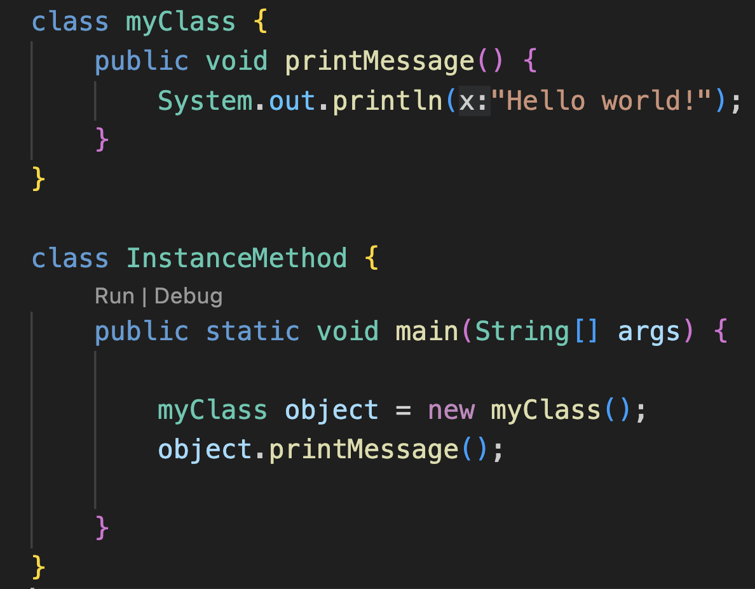
1. Class/ Object
1.1. Java Classes
1.2. Components in Java Class
1.3. Class Declaration in java
1.4. Java Object
1.5. Declaring Java Object
1.6. Class Vs Object
2 Java Methods
2.1. Declaration of methods
2.2. Types of methods
2.2.1 Predefined methods
2.2.2 User-defined methods
2.3. Ways to create methods
2.3.1 Instance Methods
2.3.2 Static Methods
2.3.3 Static vs instance
2.4. Rule to name methods
2.5. Methods Calling
3. Variables in Java
4. Java Class Constructor
4.1. Rules to create Constructor
4.2. Java Methods vs Constructor
4.3. Types of Constructor
4.4. Constructor Overloading
5. Java Access Modifier
6. Four Pillar of OOP
7. Encapsulation in Java
7.1. Getters and Setters
7.2. Implementation of Encapsulation
Instance method
Instance methods is related to an object rather than a class.
We can override an instance method as they are resolved using dynamic binding during run time.
The instance methods are stored in a single memory location.

Slide 20
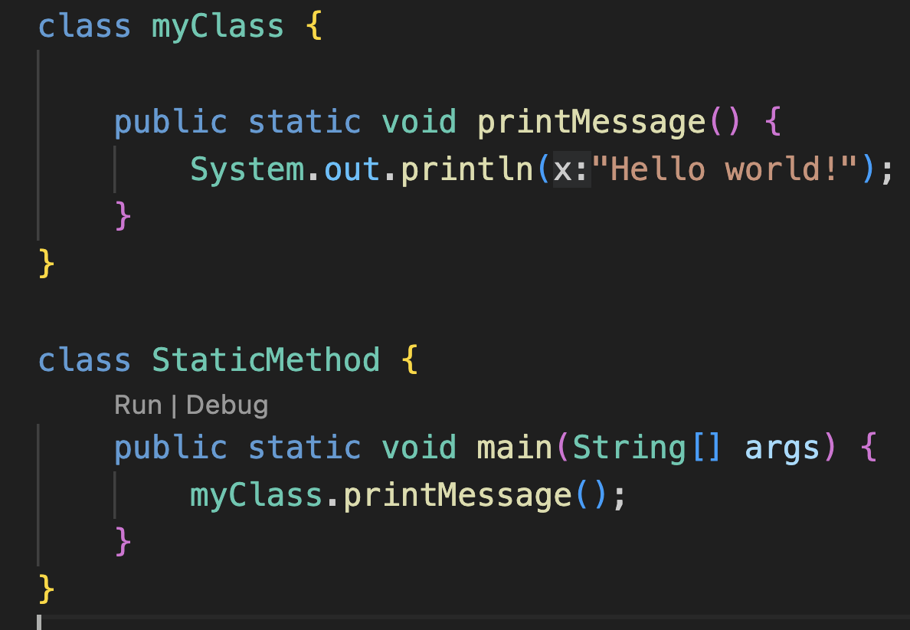
1. Class/ Object
1.1. Java Classes
1.2. Components in Java Class
1.3. Class Declaration in java
1.4. Java Object
1.5. Declaring Java Object
1.6. Class Vs Object
2 Java Methods
2.1. Declaration of methods
2.2. Types of methods
2.2.1 Predefined methods
2.2.2 User-defined methods
2.3. Ways to create methods
2.3.1 Instance Methods
2.3.2 Static Methods
2.3.3 Static vs instance
2.4. Rule to name methods
2.5. Methods Calling
3. Variables in Java
4. Java Class Constructor
4.1. Rules to create Constructor
4.2. Java Methods vs Constructor
4.3. Types of Constructor
4.4. Constructor Overloading
5. Java Access Modifier
6. Four Pillar of OOP
7. Encapsulation in Java
7.1. Getters and Setters
7.2. Implementation of Encapsulation
Static method
Static methods are designed in such a way that they can be shared among all objects created using the same class.
We cannot override static methods as they are resolved using the static binding by the compiler during compile time.

Slide 21
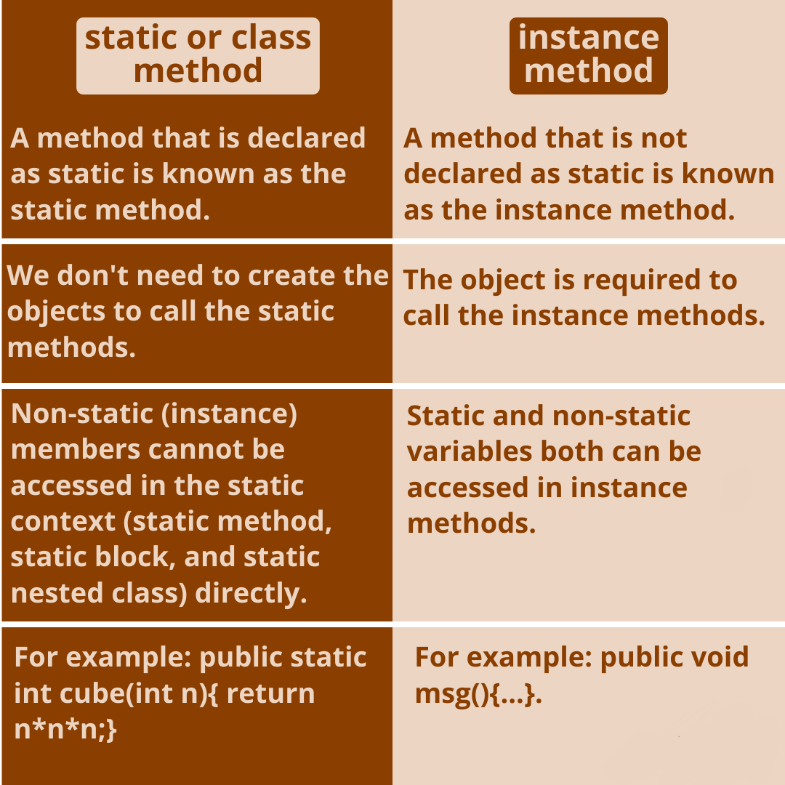
1. Class/ Object
1.1. Java Classes
1.2. Components in Java Class
1.3. Class Declaration in java
1.4. Java Object
1.5. Declaring Java Object
1.6. Class Vs Object
2 Java Methods
2.1. Declaration of methods
2.2. Types of methods
2.2.1 Predefined methods
2.2.2 User-defined methods
2.3. Ways to create methods
2.3.1 Instance Methods
2.3.2 Static Methods
2.3.3 Static vs instance
2.4. Rule to name methods
2.5. Methods Calling
3. Variables in Java
4. Java Class Constructor
4.1. Rules to create Constructor
4.2. Java Methods vs Constructor
4.3. Types of Constructor
4.4. Constructor Overloading
5. Java Access Modifier
6. Four Pillar of OOP
7. Encapsulation in Java
7.1. Getters and Setters
7.2. Implementation of Encapsulation
Instance method vs Static method

Slide 22
1. Class/ Object
1.1. Java Classes
1.2. Components in Java Class
1.3. Class Declaration in java
1.4. Java Object
1.5. Declaring Java Object
1.6. Class Vs Object
2 Java Methods
2.1. Declaration of methods
2.2. Types of methods
2.2.1 Predefined methods
2.2.2 User-defined methods
2.3. Ways to create methods
2.3.1 Instance Methods
2.3.2 Static Methods
2.3.3 Static vs instance
2.4. Rule to name methods
2.5. Methods Calling
3. Variables in Java
4. Java Class Constructor
4.1. Rules to create Constructor
4.2. Java Methods vs Constructor
4.3. Types of Constructor
4.4. Constructor Overloading
5. Java Access Modifier
6. Four Pillar of OOP
7. Encapsulation in Java
7.1. Getters and Setters
7.2. Implementation of Encapsulation
Rules to name method
While defining a method, remember that the method name must be a verb and start with a lowercase letter.
If the method name has more than two words, the first name must be a verb followed by an adjective or noun.
In the multi-word method name, the first letter of each word must be in uppercase except the first word. For example, findSum, computeMax, setX, and getX.

Slide 23
1. Class/ Object
1.1. Java Classes
1.2. Components in Java Class
1.3. Class Declaration in java
1.4. Java Object
1.5. Declaring Java Object
1.6. Class Vs Object
2 Java Methods
2.1. Declaration of methods
2.2. Types of methods
2.2.1 Predefined methods
2.2.2 User-defined methods
2.3. Ways to create methods
2.3.1 Instance Methods
2.3.2 Static Methods
2.3.3 Static vs instance
2.4. Rule to name methods
2.5. Methods Calling
3. Variables in Java
4. Java Class Constructor
4.1. Rules to create Constructor
4.2. Java Methods vs Constructor
4.3. Types of Constructor
4.4. Constructor Overloading
5. Java Access Modifier
6. Four Pillar of OOP
7. Encapsulation in Java
7.1. Getters and Setters
7.2. Implementation of Encapsulation
Method Calling
The method needs to be called for use its functionality. There can be three situations when a method is called:
A method returns to the code that invoked it when:
It completes all the statements in the method
It reaches a return statement
Throws an exception

Slide 24
1. Class/ Object
1.1. Java Classes
1.2. Components in Java Class
1.3. Class Declaration in java
1.4. Java Object
1.5. Declaring Java Object
1.6. Class Vs Object
2 Java Methods
2.1. Declaration of methods
2.2. Types of methods
2.2.1 Predefined methods
2.2.2 User-defined methods
2.3. Ways to create methods
2.3.1 Instance Methods
2.3.2 Static Methods
2.3.3 Static vs instance
2.4. Rule to name methods
2.5. Methods Calling
3. Variables in Java
4. Java Class Constructor
4.1. Rules to create Constructor
4.2. Java Methods vs Constructor
4.3. Types of Constructor
4.4. Constructor Overloading
5. Java Access Modifier
6. Four Pillar of OOP
7. Encapsulation in Java
7.1. Getters and Setters
7.2. Implementation of Encapsulation
Variables in Java
Class variables
Class variables also known as static variables are declared with the static keyword in a class, but outside a method, constructor or a block.
Instance variables
Instance variables are declared in a class, but outside a method. When space is allocated for an object in the heap, a slot for each instance variable value is created.

Slide 25
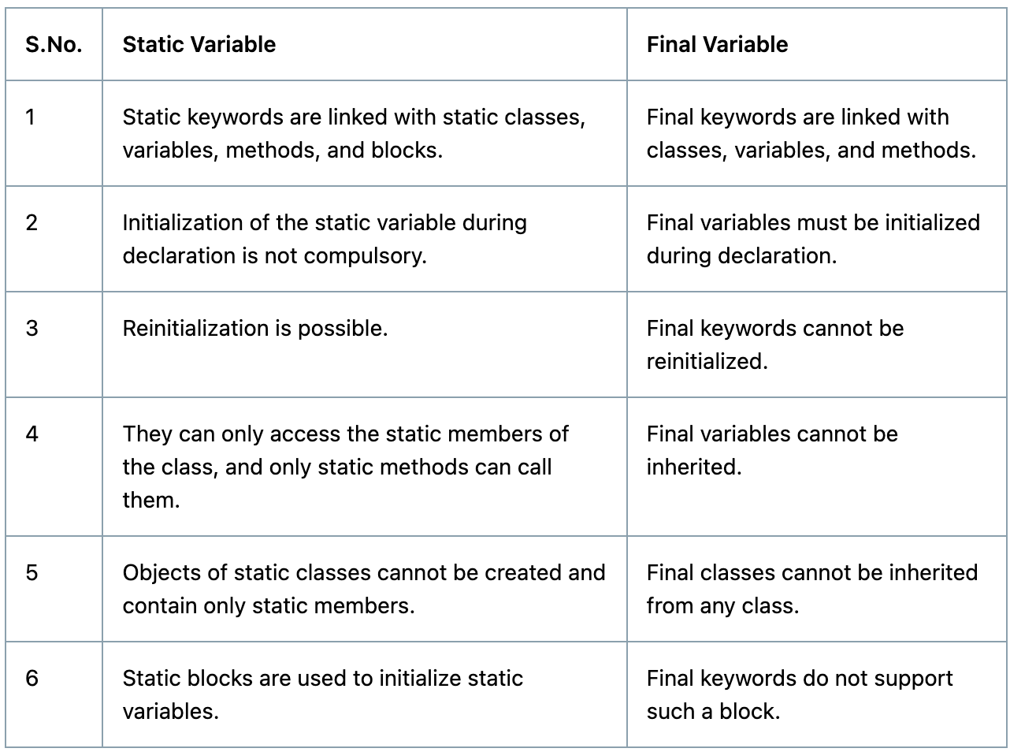
1. Class/ Object
1.1. Java Classes
1.2. Components in Java Class
1.3. Class Declaration in java
1.4. Java Object
1.5. Declaring Java Object
1.6. Class Vs Object
2 Java Methods
2.1. Declaration of methods
2.2. Types of methods
2.2.1 Predefined methods
2.2.2 User-defined methods
2.3. Ways to create methods
2.3.1 Instance Methods
2.3.2 Static Methods
2.3.3 Static vs instance
2.4. Rule to name methods
2.5. Methods Calling
3. Variables in Java
4. Java Class Constructor
4.1. Rules to create Constructor
4.2. Java Methods vs Constructor
4.3. Types of Constructor
4.4. Constructor Overloading
5. Java Access Modifier
6. Four Pillar of OOP
7. Encapsulation in Java
7.1. Getters and Setters
7.2. Implementation of Encapsulation
Final vs static variable

Slide 26
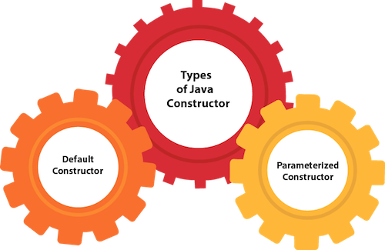
1. Class/ Object
1.1. Java Classes
1.2. Components in Java Class
1.3. Class Declaration in java
1.4. Java Object
1.5. Declaring Java Object
1.6. Class Vs Object
2 Java Methods
2.1. Declaration of methods
2.2. Types of methods
2.2.1 Predefined methods
2.2.2 User-defined methods
2.3. Ways to create methods
2.3.1 Instance Methods
2.3.2 Static Methods
2.3.3 Static vs instance
2.4. Rule to name methods
2.5. Methods Calling
3. Variables in Java
4. Java Class Constructor
4.1. Rules to create Constructor
4.2. Java Methods vs Constructor
4.3. Types of Constructor
4.4. Constructor Overloading
5. Java Access Modifier
6. Four Pillar of OOP
7. Encapsulation in Java
7.1. Getters and Setters
7.2. Implementation of Encapsulation
Java Constructor
A constructor in Java is a special method that is used to
initialize objects.
The constructor is called when an object of a class is created.
It can be used to set initial values for object attributes.

Slide 27
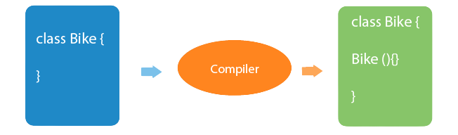
1. Class/ Object
1.1. Java Classes
1.2. Components in Java Class
1.3. Class Declaration in java
1.4. Java Object
1.5. Declaring Java Object
1.6. Class Vs Object
2 Java Methods
2.1. Declaration of methods
2.2. Types of methods
2.2.1 Predefined methods
2.2.2 User-defined methods
2.3. Ways to create methods
2.3.1 Instance Methods
2.3.2 Static Methods
2.3.3 Static vs instance
2.4. Rule to name methods
2.5. Methods Calling
3. Variables in Java
4. Java Class Constructor
4.1. Rules to create Constructor
4.2. Java Methods vs Constructor
4.3. Types of Constructor
4.4. Constructor Overloading
5. Java Access Modifier
6. Four Pillar of OOP
7. Encapsulation in Java
7.1. Getters and Setters
7.2. Implementation of Encapsulation
Rules for creating Java constructor
There are two rules defined for the constructor.
Constructor name must be the same as its class name.
A Constructor must have no explicit return type.
A constructor is called "Default Constructor" when it doesn't have any parameter.

Slide 28
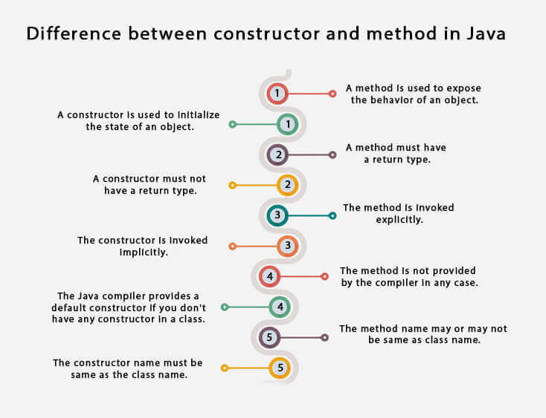
1. Class/ Object
1.1. Java Classes
1.2. Components in Java Class
1.3. Class Declaration in java
1.4. Java Object
1.5. Declaring Java Object
1.6. Class Vs Object
2 Java Methods
2.1. Declaration of methods
2.2. Types of methods
2.2.1 Predefined methods
2.2.2 User-defined methods
2.3. Ways to create methods
2.3.1 Instance Methods
2.3.2 Static Methods
2.3.3 Static vs instance
2.4. Rule to name methods
2.5. Methods Calling
3. Variables in Java
4. Java Class Constructor
4.1. Rules to create Constructor
4.2. Java Methods vs Constructor
4.3. Types of Constructor
4.4. Constructor Overloading
5. Java Access Modifier
6. Four Pillar of OOP
7. Encapsulation in Java
7.1. Getters and Setters
7.2. Implementation of Encapsulation
Constructor vs Method

Slide 29
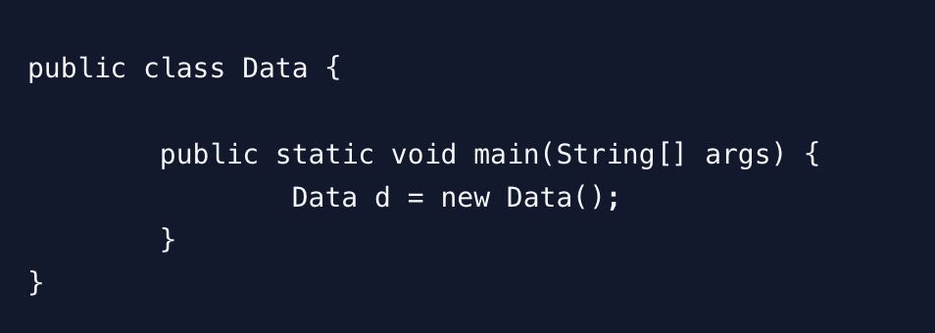
1. Class/ Object
1.1. Java Classes
1.2. Components in Java Class
1.3. Class Declaration in java
1.4. Java Object
1.5. Declaring Java Object
1.6. Class Vs Object
2 Java Methods
2.1. Declaration of methods
2.2. Types of methods
2.2.1 Predefined methods
2.2.2 User-defined methods
2.3. Ways to create methods
2.3.1 Instance Methods
2.3.2 Static Methods
2.3.3 Static vs instance
2.4. Rule to name methods
2.5. Methods Calling
3. Variables in Java
4. Java Class Constructor
4.1. Rules to create Constructor
4.2. Java Methods vs Constructor
4.3. Types of Constructor
4.4. Constructor Overloading
5. Java Access Modifier
6. Four Pillar of OOP
7. Encapsulation in Java
7.1. Getters and Setters
7.2. Implementation of Encapsulation
Default Constructor in Java
It’s not required to always provide a constructor implementation in the class code.
If we don’t provide a constructor, then java provides default constructor implementation for us to use.

Slide 30
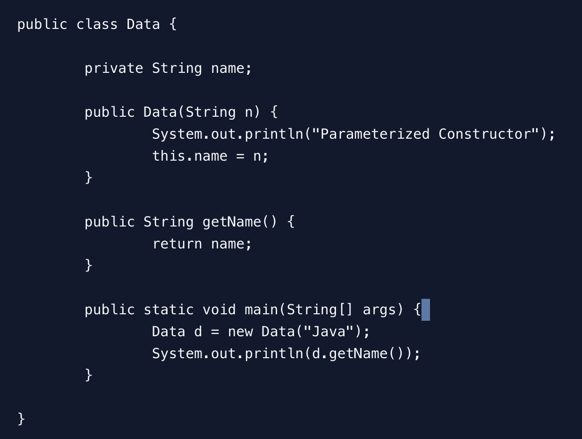
1. Class/ Object
1.1. Java Classes
1.2. Components in Java Class
1.3. Class Declaration in java
1.4. Java Object
1.5. Declaring Java Object
1.6. Class Vs Object
2 Java Methods
2.1. Declaration of methods
2.2. Types of methods
2.2.1 Predefined methods
2.2.2 User-defined methods
2.3. Ways to create methods
2.3.1 Instance Methods
2.3.2 Static Methods
2.3.3 Static vs instance
2.4. Rule to name methods
2.5. Methods Calling
3. Variables in Java
4. Java Class Constructor
4.1. Rules to create Constructor
4.2. Java Methods vs Constructor
4.3. Types of Constructor
4.4. Constructor Overloading
5. Java Access Modifier
6. Four Pillar of OOP
7. Encapsulation in Java
7.1. Getters and Setters
7.2. Implementation of Encapsulation
Parameterized Constructor in Java
Constructor with arguments is called parameterized constructor. Let’s look at the example of parameterized constructor in java.

Slide 31
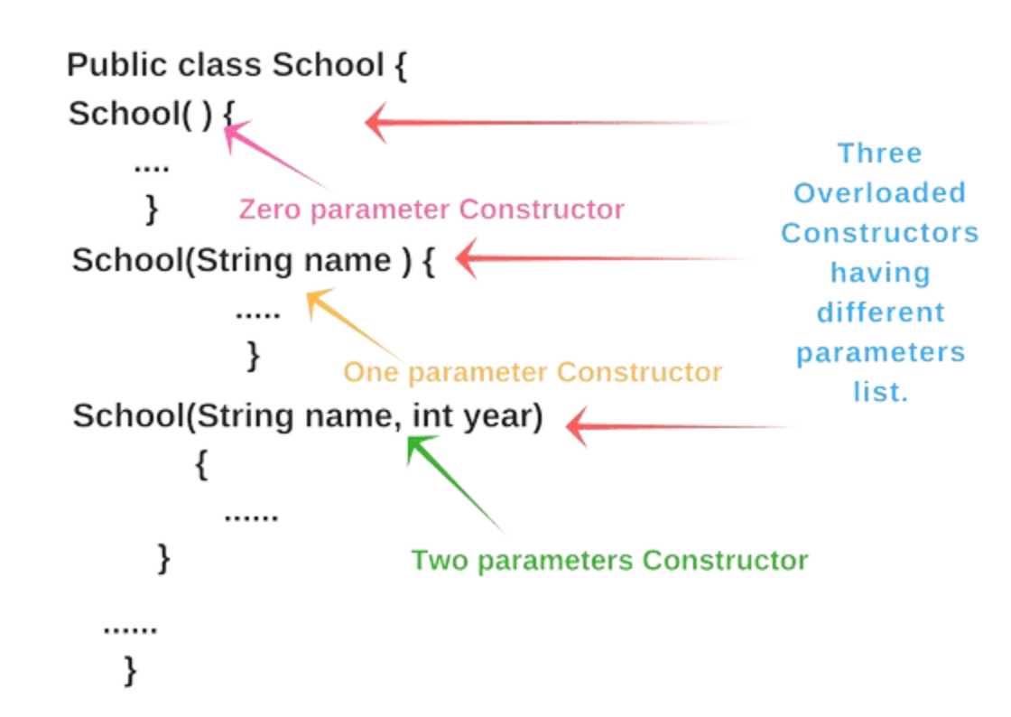
1. Class/ Object
1.1. Java Classes
1.2. Components in Java Class
1.3. Class Declaration in java
1.4. Java Object
1.5. Declaring Java Object
1.6. Class Vs Object
2 Java Methods
2.1. Declaration of methods
2.2. Types of methods
2.2.1 Predefined methods
2.2.2 User-defined methods
2.3. Ways to create methods
2.3.1 Instance Methods
2.3.2 Static Methods
2.3.3 Static vs instance
2.4. Rule to name methods
2.5. Methods Calling
3. Variables in Java
4. Java Class Constructor
4.1. Rules to create Constructor
4.2. Java Methods vs Constructor
4.3. Types of Constructor
4.4. Constructor Overloading
5. Java Access Modifier
6. Four Pillar of OOP
7. Encapsulation in Java
7.1. Getters and Setters
7.2. Implementation of Encapsulation
Constructor Overloading
We can overload constructors like methods.
The constructor overloading can be defined as the concept of having more than one constructor with different parameters so that every constructor can perform a different task.

Slide 32
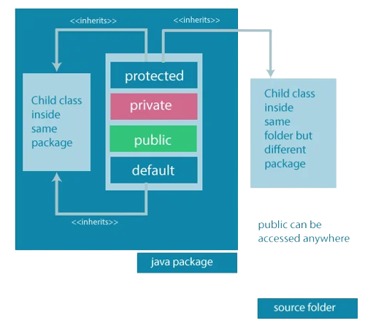
1. Class/ Object
1.1. Java Classes
1.2. Components in Java Class
1.3. Class Declaration in java
1.4. Java Object
1.5. Declaring Java Object
1.6. Class Vs Object
2 Java Methods
2.1. Declaration of methods
2.2. Types of methods
2.2.1 Predefined methods
2.2.2 User-defined methods
2.3. Ways to create methods
2.3.1 Instance Methods
2.3.2 Static Methods
2.3.3 Static vs instance
2.4. Rule to name methods
2.5. Methods Calling
3. Variables in Java
4. Java Class Constructor
4.1. Rules to create Constructor
4.2. Java Methods vs Constructor
4.3. Types of Constructor
4.4. Constructor Overloading
5. Java Access Modifier
6. Four Pillar of OOP
7. Encapsulation in Java
7.1. Getters and Setters
7.2. Implementation of Encapsulation
Java Access modifiers

Slide 33
1. Class/ Object
1.1. Java Classes
1.2. Components in Java Class
1.3. Class Declaration in java
1.4. Java Object
1.5. Declaring Java Object
1.6. Class Vs Object
2 Java Methods
2.1. Declaration of methods
2.2. Types of methods
2.2.1 Predefined methods
2.2.2 User-defined methods
2.3. Ways to create methods
2.3.1 Instance Methods
2.3.2 Static Methods
2.3.3 Static vs instance
2.4. Rule to name methods
2.5. Methods Calling
3. Variables in Java
4. Java Class Constructor
4.1. Rules to create Constructor
4.2. Java Methods vs Constructor
4.3. Types of Constructor
4.4. Constructor Overloading
5. Java Access Modifier
6. Four Pillar of OOP
7. Encapsulation in Java
7.1. Getters and Setters
7.2. Implementation of Encapsulation
Java Access modifiers
The access modifiers in Java specifies the accessibility or scope of a field, method, constructor, or class.
We can change the access level of fields, constructors, methods, and class by applying the access modifier on it.
There are four types of Java access modifiers:
Private
Default
Protected
Public

Slide 34
1. Class/ Object
1.1. Java Classes
1.2. Components in Java Class
1.3. Class Declaration in java
1.4. Java Object
1.5. Declaring Java Object
1.6. Class Vs Object
2 Java Methods
2.1. Declaration of methods
2.2. Types of methods
2.2.1 Predefined methods
2.2.2 User-defined methods
2.3. Ways to create methods
2.3.1 Instance Methods
2.3.2 Static Methods
2.3.3 Static vs instance
2.4. Rule to name methods
2.5. Methods Calling
3. Variables in Java
4. Java Class Constructor
4.1. Rules to create Constructor
4.2. Java Methods vs Constructor
4.3. Types of Constructor
4.4. Constructor Overloading
5. Java Access Modifier
6. Four Pillar of OOP
7. Encapsulation in Java
7.1. Getters and Setters
7.2. Implementation of Encapsulation
Private: The access level of a private modifier is only within the class. It cannot be accessed from outside the class.
Default: The access level of a default modifier is only within the package. It cannot be accessed from outside the package. If you do not specify any access level, it will be the default.
Protected: The access level of a protected modifier is within the package and outside the package through child class. If you do not make the child class, it cannot be accessed from outside the package.
Public: It can be accessed from within the class, outside the class, within the package and outside the package.

Slide 35
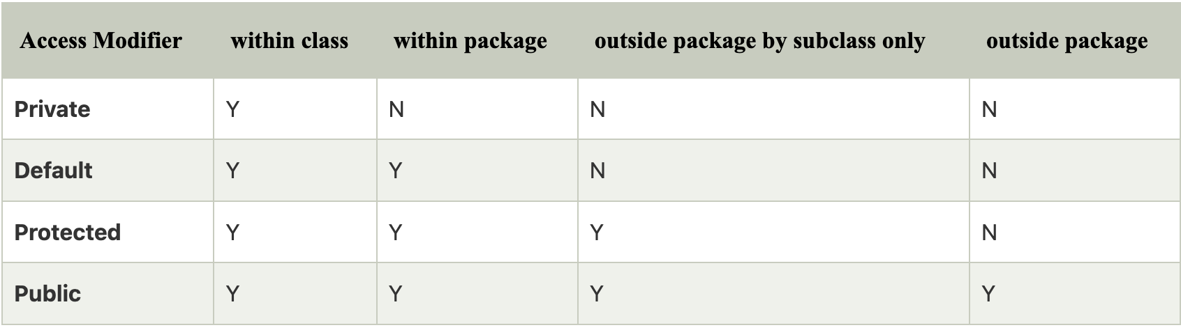
1. Class/ Object
1.1. Java Classes
1.2. Components in Java Class
1.3. Class Declaration in java
1.4. Java Object
1.5. Declaring Java Object
1.6. Class Vs Object
2 Java Methods
2.1. Declaration of methods
2.2. Types of methods
2.2.1 Predefined methods
2.2.2 User-defined methods
2.3. Ways to create methods
2.3.1 Instance Methods
2.3.2 Static Methods
2.3.3 Static vs instance
2.4. Rule to name methods
2.5. Methods Calling
3. Variables in Java
4. Java Class Constructor
4.1. Rules to create Constructor
4.2. Java Methods vs Constructor
4.3. Types of Constructor
4.4. Constructor Overloading
5. Java Access Modifier
6. Four Pillar of OOP
7. Encapsulation in Java
7.1. Getters and Setters
7.2. Implementation of Encapsulation

Slide 36
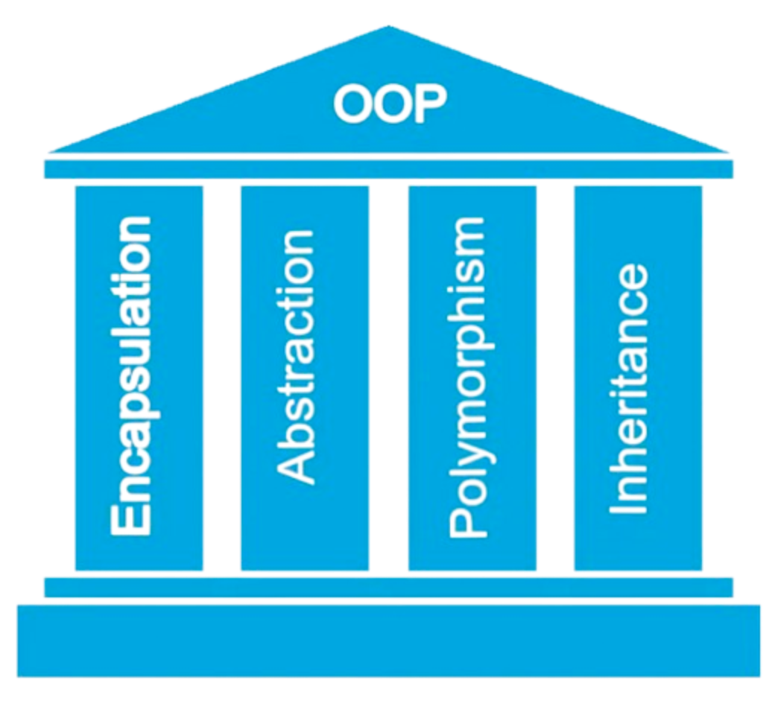
1. Class/ Object
1.1. Java Classes
1.2. Components in Java Class
1.3. Class Declaration in java
1.4. Java Object
1.5. Declaring Java Object
1.6. Class Vs Object
2 Java Methods
2.1. Declaration of methods
2.2. Types of methods
2.2.1 Predefined methods
2.2.2 User-defined methods
2.3. Ways to create methods
2.3.1 Instance Methods
2.3.2 Static Methods
2.3.3 Static vs instance
2.4. Rule to name methods
2.5. Methods Calling
3. Variables in Java
4. Java Class Constructor
4.1. Rules to create Constructor
4.2. Java Methods vs Constructor
4.3. Types of Constructor
4.4. Constructor Overloading
5. Java Access Modifier
6. Four Pillar of OOP
7. Encapsulation in Java
7.1. Getters and Setters
7.2. Implementation of Encapsulation
Four pillars of Java
OOPS moves around its four most important pillars.
They are:
Inheritance,
Polymorphism,
Abstraction,
Encapsulation.

Slide 37
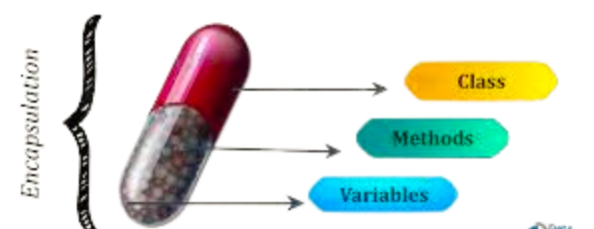
1. Class/ Object
1.1. Java Classes
1.2. Components in Java Class
1.3. Class Declaration in java
1.4. Java Object
1.5. Declaring Java Object
1.6. Class Vs Object
2 Java Methods
2.1. Declaration of methods
2.2. Types of methods
2.2.1 Predefined methods
2.2.2 User-defined methods
2.3. Ways to create methods
2.3.1 Instance Methods
2.3.2 Static Methods
2.3.3 Static vs instance
2.4. Rule to name methods
2.5. Methods Calling
3. Variables in Java
4. Java Class Constructor
4.1. Rules to create Constructor
4.2. Java Methods vs Constructor
4.3. Types of Constructor
4.4. Constructor Overloading
5. Java Access Modifier
6. Four Pillar of OOP
7. Encapsulation in Java
7.1. Getters and Setters
7.2. Implementation of Encapsulation
Encapsulation in Java
Encapsulation is a mechanism to bundle the data and code acting on the data together as a single unit.
There are two steps to achieve encapsulation in Java
declare the variable of a class as private
Provide a Public setter and getter method to modify and view the values of the variables.

Slide 38
1. Class/ Object
1.1. Java Classes
1.2. Components in Java Class
1.3. Class Declaration in java
1.4. Java Object
1.5. Declaring Java Object
1.6. Class Vs Object
2 Java Methods
2.1. Declaration of methods
2.2. Types of methods
2.2.1 Predefined methods
2.2.2 User-defined methods
2.3. Ways to create methods
2.3.1 Instance Methods
2.3.2 Static Methods
2.3.3 Static vs instance
2.4. Rule to name methods
2.5. Methods Calling
3. Variables in Java
4. Java Class Constructor
4.1. Rules to create Constructor
4.2. Java Methods vs Constructor
4.3. Types of Constructor
4.4. Constructor Overloading
5. Java Access Modifier
6. Four Pillar of OOP
7. Encapsulation in Java
7.1. Getters and Setters
7.2. Implementation of Encapsulation
Getters and Setters
Getter in Java: Getter returns the value (accessors), it returns the value of data type int, String, double, float, etc. For the program’s convenience, the getter starts with the word “get” followed by the variable name.
Setter in Java: While Setter sets or updates the value (mutators). It sets the value for any variable used in a class’s programs. and starts with the word “set” followed by the variable name.

Slide 39
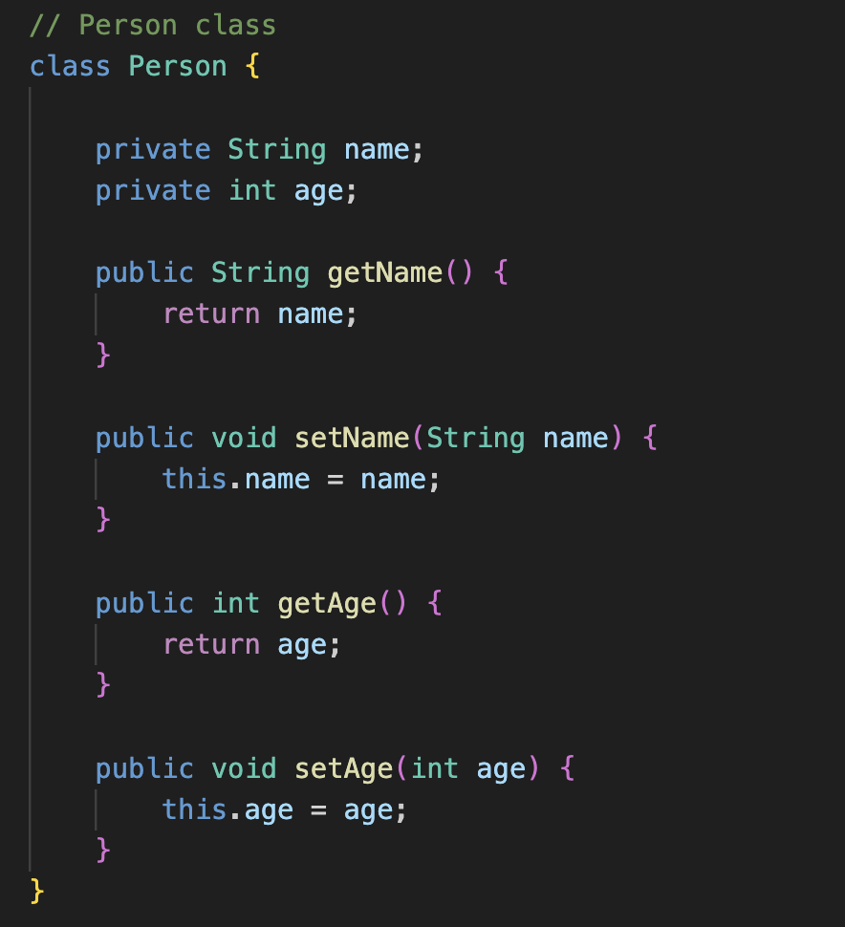
1. Class/ Object
1.1. Java Classes
1.2. Components in Java Class
1.3. Class Declaration in java
1.4. Java Object
1.5. Declaring Java Object
1.6. Class Vs Object
2 Java Methods
2.1. Declaration of methods
2.2. Types of methods
2.2.1 Predefined methods
2.2.2 User-defined methods
2.3. Ways to create methods
2.3.1 Instance Methods
2.3.2 Static Methods
2.3.3 Static vs instance
2.4. Rule to name methods
2.5. Methods Calling
3. Variables in Java
4. Java Class Constructor
4.1. Rules to create Constructor
4.2. Java Methods vs Constructor
4.3. Types of Constructor
4.4. Constructor Overloading
5. Java Access Modifier
6. Four Pillar of OOP
7. Encapsulation in Java
7.1. Getters and Setters
7.2. Implementation of Encapsulation
Implementing Encapsulation
Person Class:

Slide 40
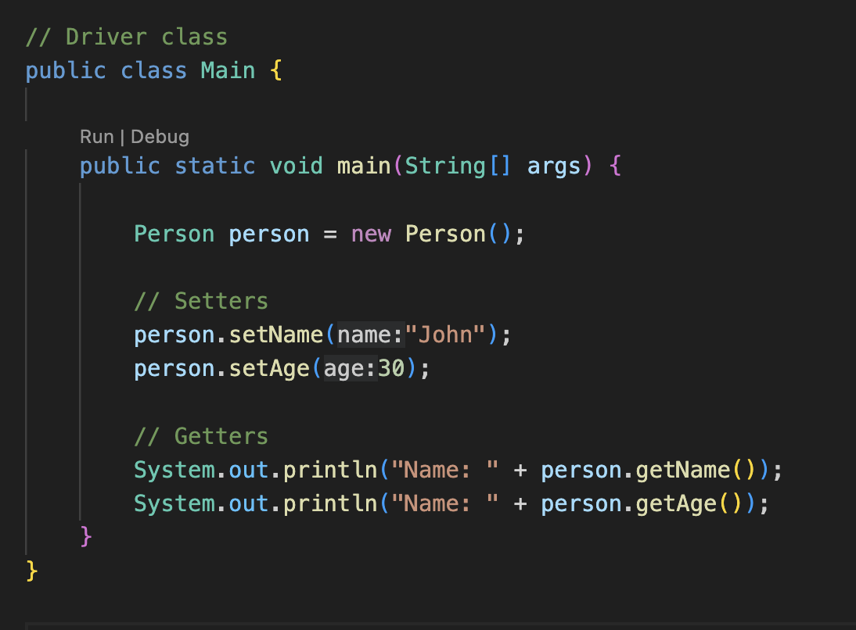
1. Class/ Object
1.1. Java Classes
1.2. Components in Java Class
1.3. Class Declaration in java
1.4. Java Object
1.5. Declaring Java Object
1.6. Class Vs Object
2 Java Methods
2.1. Declaration of methods
2.2. Types of methods
2.2.1 Predefined methods
2.2.2 User-defined methods
2.3. Ways to create methods
2.3.1 Instance Methods
2.3.2 Static Methods
2.3.3 Static vs instance
2.4. Rule to name methods
2.5. Methods Calling
3. Variables in Java
4. Java Class Constructor
4.1. Rules to create Constructor
4.2. Java Methods vs Constructor
4.3. Types of Constructor
4.4. Constructor Overloading
5. Java Access Modifier
6. Four Pillar of OOP
7. Encapsulation in Java
7.1. Getters and Setters
7.2. Implementation of Encapsulation
Driver Class:

Slide 41


